Slide 1

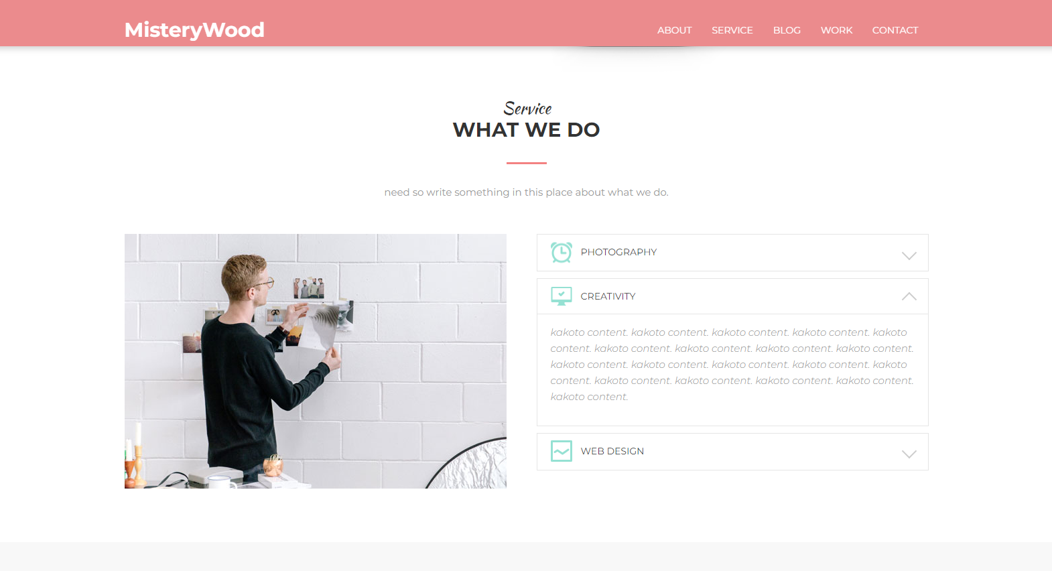
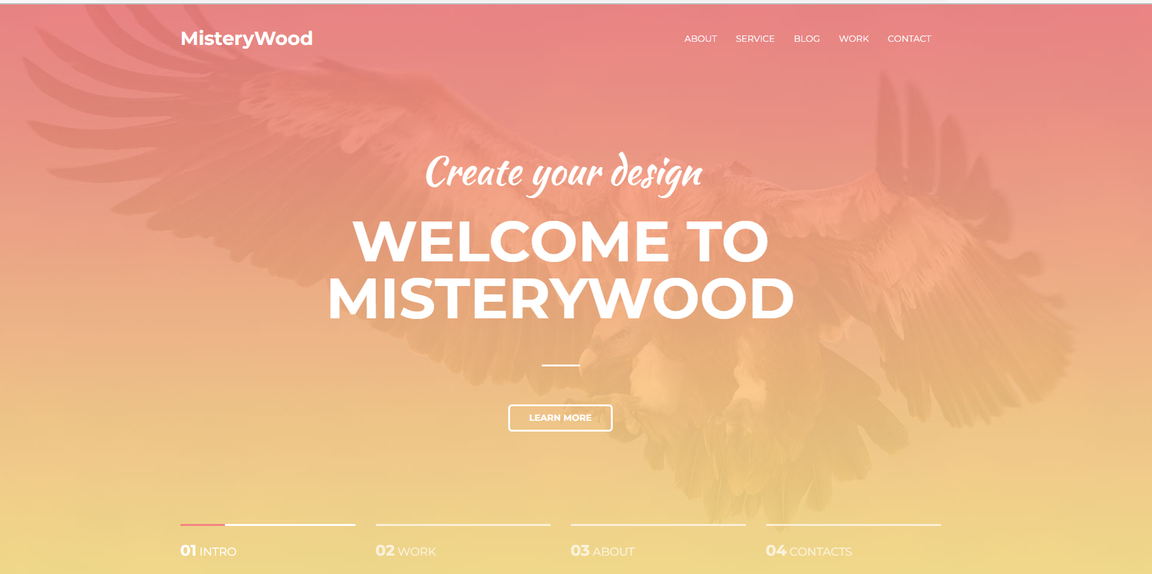
Test case how to use MISTERYWOOD webpage

Slide 2
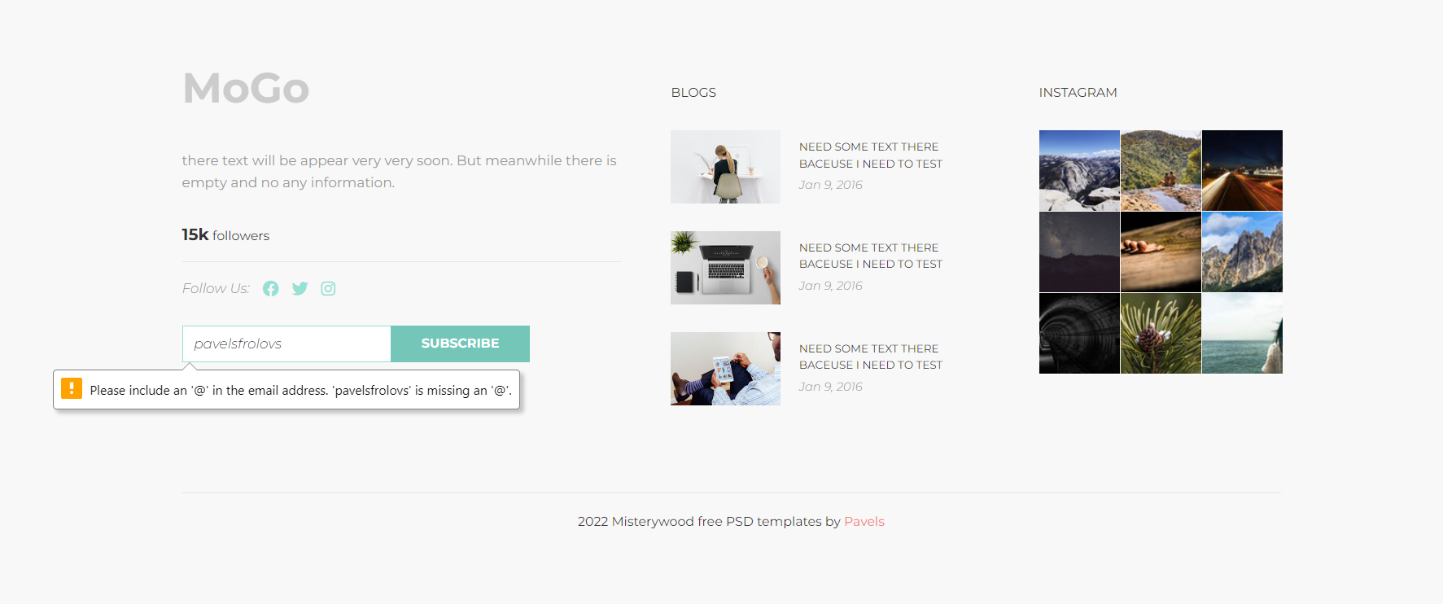
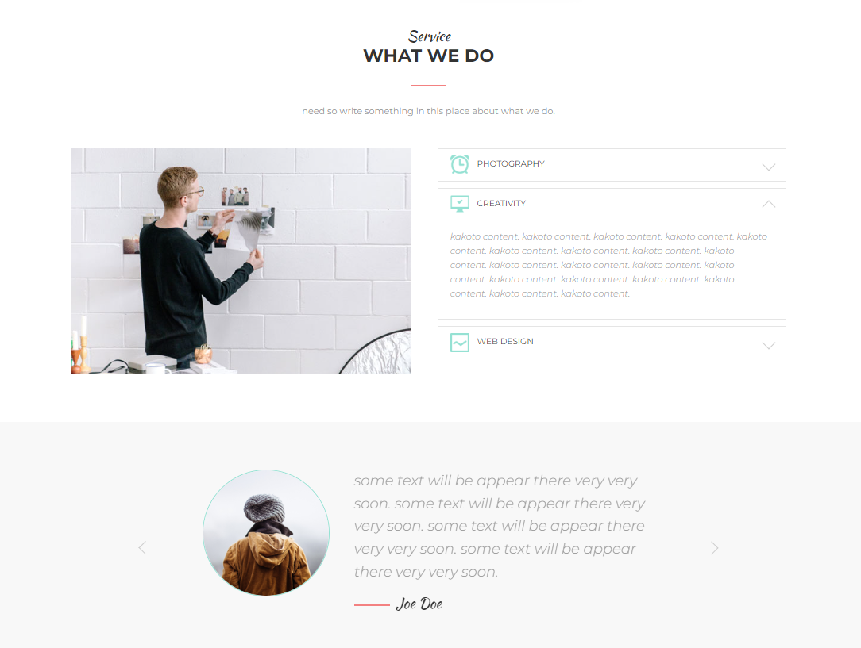
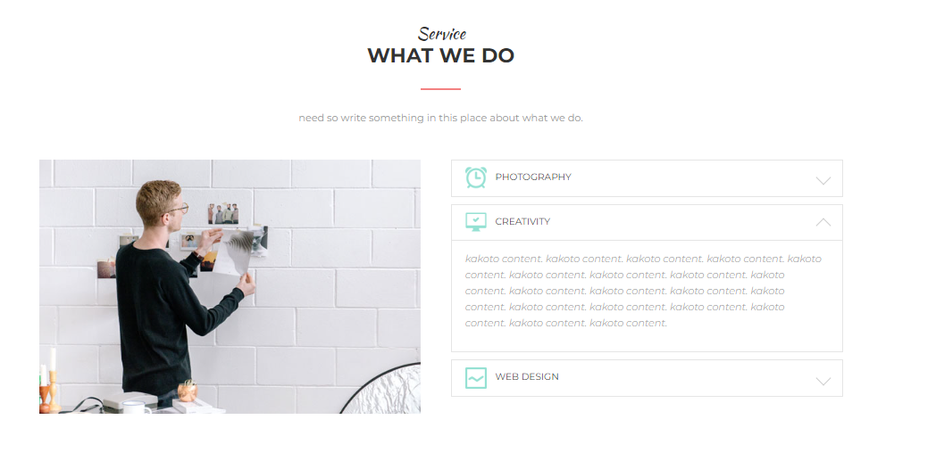
Last page
Subscribe button
(1. Redirects you to another page. 2. Warns that the "@" character is required for input)

Slide 3
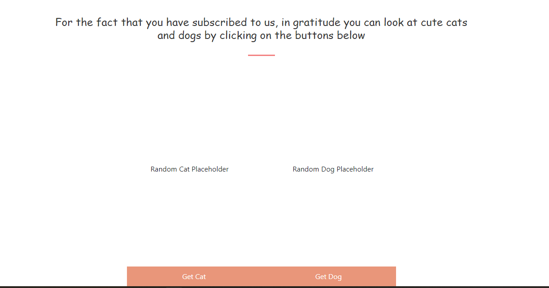
Thank you page for subscribing
(By clicking on the button "Get cat" or "Get dog" you get a random picture of displaced animals )

Slide 4
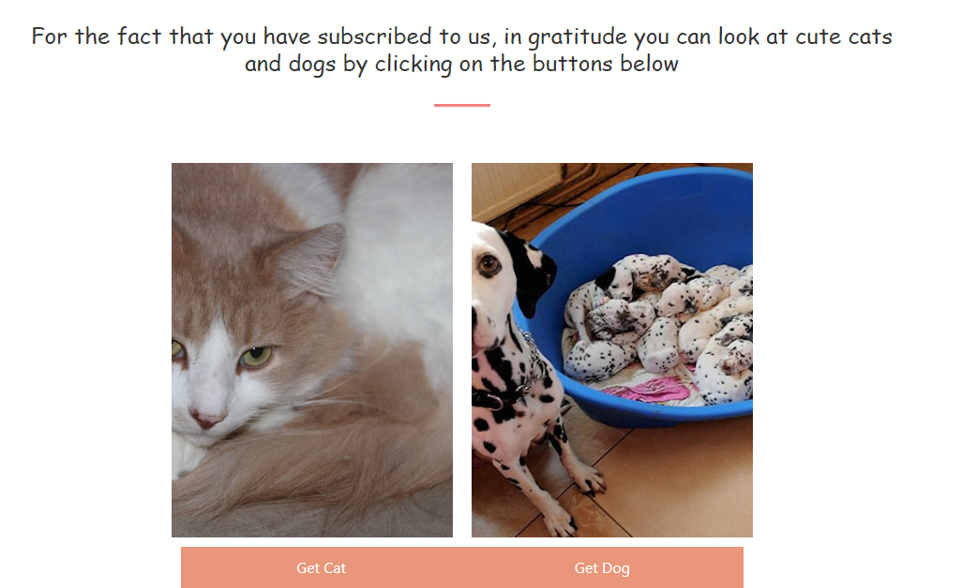
Thank you page for subscribing
(And every time you click you get a new picture)

